Slide 1
Two emerging economies,
Brazil and China,
To propose an evaluation of their recent development in terms of growth performance and the evolution of income inequality.
Our analysis therefore seems to be related to the well known Kuznets-curve and theory
The latter, however, populates an inequality-growth plane with countries’ average-valued coordinates and draws far fetching predictions that have been repeatedly questioned.
In the same K-plane we introduce the dual notion (based upon coordinates that are (bi-variate time series) of
(a population of) growth models.
Accordingly, we re-interpret the comparative histories of these two emerging economies to show how Kuznets’ traditional approach does not capture recent relevant phenomena characterizing such countries, and perhaps others as well:
namely, the presence of at least two distinct growth models, one prevailing in China for most of its recent history, the other associated with Brazil.
Descriptive statistics and Cointegration analysis corroborate such results. Our research is meant also to begin to rationalize various attempts to interpret such phenomena as of the so called East Asian Miracle countries, and the Middle Income trap. In fact, our analysis runs against the backdrop of the extensive literature on the relationship between income inequality and growth/development, so that a review, albeit brief, is in order.

Slide 2
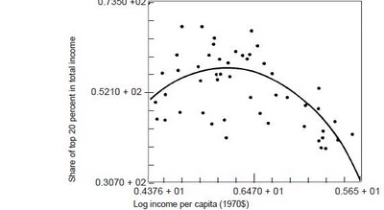
The k-curve

Slide 3
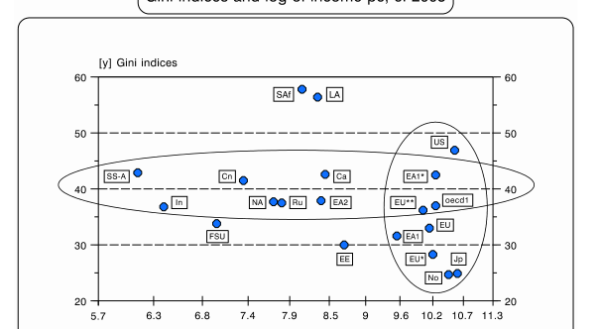

Slide 4
An econometric exercise shows
that in both countries pc GDP and income inequality stand in a co-integrated, long-term relationship.
However, in China such relationship is positive while in Brazil it is negative
Moreover, while VAR Granger causal relationships indicate that China’s economic growth “predetermines” or “Grange-causes” income inequality (perhaps, one could say á la Kuznets);
in Brazil the causal relationship seems to be reversed.

Slide 6
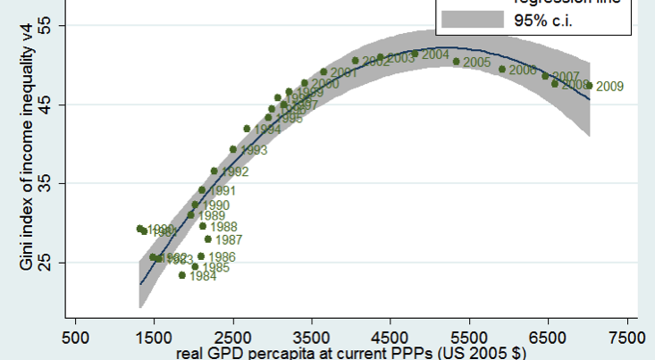

Slide 7
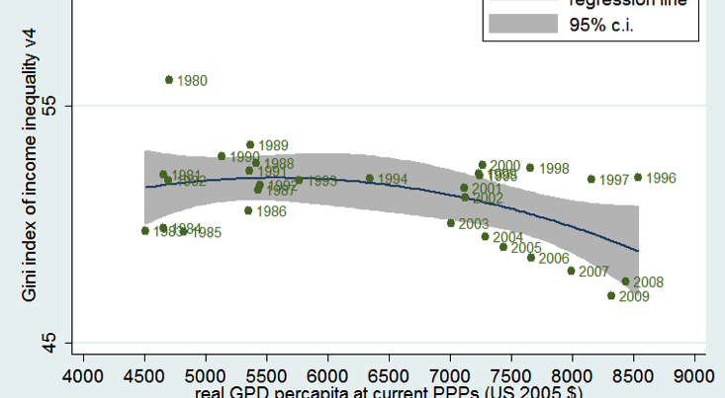

Slide 8
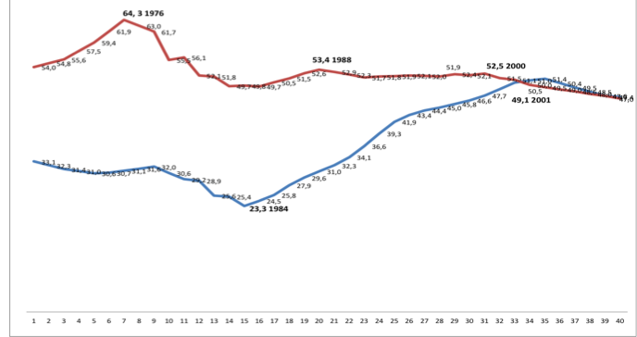

Slide 9
