Slide 1
Conceptualizing Capitalism Institutions, Evolution, Future
Geoffrey M Hodgson
Introduction
DISCOVERING CAPITALISM
1. Distilling the essence
2. Social structure and individual motivation
3. Law and the state
4. Property, possession and contract
5. Commodity exchange and markets
6. Money and finance
7. Meanings of capital
8. Firms and corporations
9. Labor and employment
10. The essence of capitalism
Today’s Lecture
/ 27

Slide 2
Conceptualizing Capitalism Institutions, Evolution, Future
Geoffrey M Hodgson
ASSESSING CAPITALISM
Conceptualizing production
Socialism, capitalism, and the state
How does capitalism evolve?
The future of global capitalism
Addressing inequality
Capitalism and beyond
Coda on legal institutionalism
/ 27

Slide 3
Conceptualizing Capitalism
Lecture 2: Property, exchange and markets
The distinction between property and possession.
Possession refers to the control of a good or resource. It is more about the ability to make effective use, than an established right. Possession is a relation between a person and a thing.
Richard Pipes (1999): “Possession refers to the physical control of assets, material or incorporeal, without formal title to them.”
Richard Pipes (1999): “Property refers to the right of the owner or owners, formally acknowledged by public authority, both to exploit assets to the exclusion of everyone else and to dispose of them by sale or otherwise …
… Before the state there is only possession.”
First state – 14,000 years ago in the Levant.
/ 27

Slide 4
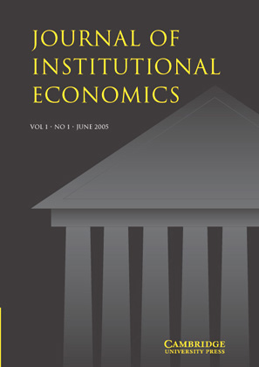
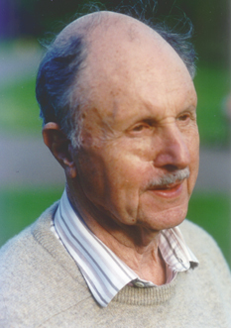
Conceptualizing Capitalism
Lecture 2: Property, exchange and markets
The distinction between property and possession.
Antony M. Honoré (1961): “To have worked out the notion of ‘having a right to’ as distinct from merely ‘having’ … was a major intellectual achievement. Without it society would have been impossible.”
Honoré (1961): “It is not enough for a legal system to recognize the possibility of people owning things. There must be rules laying down how ownership is acquired and lost and how claims to a thing are to rank inter se.”
Honoré (1961): “A people … who meant by meum and tuum no more than ‘what I (or you) presently hold’ would live in a world that is not our world.”
/ 27

Slide 5
Conceptualizing Capitalism
Lecture 2: Property, exchange and markets
The distinction between property and possession.
Different types of property (or ownership) right include the right to use a tangible or intangible asset (usus),
the right to appropriate the returns from the asset (usus fructus),
the right to change a good in substance or location (abusus),
the right to sell a good (alienation),
the right to the capital derived from the use of the good as collateral,
and several other rights or limitations (Hohfeld 1919, Honoré 1961, Pejovich 1990).
/ 27

Slide 6
Conceptualizing Capitalism
Lecture 2: Property, exchange and markets
The distinction between property and possession.
Crucially for capitalism, durable and alienable property can be used by its owner as collateral and can involve legal encumbrances (Heinsohn and Steiger 2000, 2013, Stadermann 2002, Arner et al. 2007, Steiger 2008).
The registration of much property – particularly land and buildings – and a registration system for the identification of property and owners, are crucial for economic development: they enable the use of such property as collateral for loans (Simpson 1976, De Soto 2000, Arruñada 2012).
/ 27

Slide 7
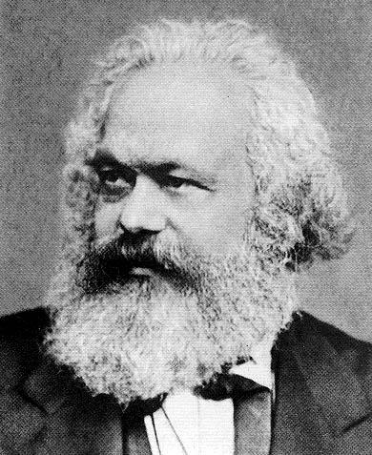
Conceptualizing Capitalism
Lecture 2: Property, exchange and markets
The distinction between property and possession.
Marx’s numerous discussions of “property” have little to say about legal rights, and he conflates property with possession.
Marx in 1844 addressed “private property” and argued that “an object is only ours when we have it – … when we directly possess, eat, drink, wear, inhabit it, etc., – in short, when we use it.”
With Marx, effective power over something, i.e. might, makes a de facto right. Legal and moral aspects of property are overshadowed.
/ 27

Slide 8
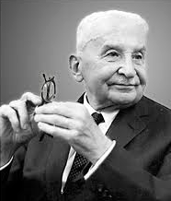
Conceptualizing Capitalism
Lecture 2: Property, exchange and markets
The distinction between property and possession.
Ludwig von Mises (1981):
“ownership is the having of the goods … This having may be called the natural or original ownership, as it is purely a physical relationship of man to the goods, independent of social relations between men or of a legal order. … Economically … the natural having alone is relevant, and the economic significance of the legal should have lies only in the support it lends to the acquisition, the maintenance, and the regaining of the natural having.”
Affinity with Marx’s view: property = power over objects!
/ 27

Slide 9
Conceptualizing Capitalism
Lecture 2: Property, exchange and markets
The distinction between property and possession.
Yoram Barzel (1994) defined property as:
“an individual’s net valuation, in expected terms, of the ability to directly consume the services of the asset, or to consume it indirectly through exchange. A key word is ability: the definition is concerned not with what people are legally entitled to do but with what they believe they can do.”
Again an affinity with Marx’s view:
property = power over objects!
/ 27

Slide 10
Conceptualizing Capitalism
Lecture 2: Property, exchange and markets
Dean Lueck and Thomas Miceli (2007): much literature in economics on property rights “remains ignorant of property law.”
“Property rights economics” is about neither property nor rights!
/ 27

Slide 11
Conceptualizing Capitalism
Lecture 2: Property, exchange and markets
Do legal property rights matter?
Joseph Stiglitz (1994):
“there is some question about whether the absence of well-defined property rights is the central problem. …
… the absence of well-defined property rights [in China] has not prevented double-digit growth rates.”
China’s explosive growth started after 1978 when land-use (usus fructus) rights were widely conceded to the peasants (Zhou 1996, Oi 1999, Coase and Wang 2012).
/ 27

Slide 12
Conceptualizing Capitalism
Lecture 2: Property, exchange and markets
The distinction between property and possession
Much economics has a crude social ontology of agent-object relations. Neglected are agent-to-agent interactions that engender and sustain shared interpretations, meanings, understandings, rules, and institutional facts (Searle 1995).
Property relations, which involve agent-to-agent relations and shared understandings concerning rules and rights, are transformed into relations of possession between agents and physical objects or processes.
Economic value is seen as deriving from some measurable physical activity, substance or sensation, such as embodied labor time or utility (Orléan 2011).
/ 27

Slide 13
Conceptualizing Capitalism
Lecture 2: Property, exchange and markets
Exchange and contract
In sociology the “exchange theory” of George Homans (1961) and Peter Blau (1964): – activities including gift-giving and interpersonal communications as “exchanges.”
James Coleman (1990): exchange as a “pairwise exchange of resources”.
Ludwig von Mises (1949): all action, even by an isolated individual, is“exchange” – attempts to swap inferior for superior circumstances.
Georg Simmel (1907): production as “exchange with nature”
Irving Fisher (1907): producers “continually hunting ... for bargains with Nature.”
/ 27

Slide 14
Conceptualizing Capitalism
Lecture 2: Property, exchange and markets
Exchange and contract
Karl H. Rau (1835), Henry Dunning MacLeod (1878), and John R. Commons (1924): commodity exchange is a contractual interchange of legal rights (along with any transferred goods or money).
A legal contract is a voluntary agreement by two or more parties with the shared intention of creating legal obligations.
Avner Greif, Paul Milgrom and Barry R. Weingast (1994): “the effectiveness of institutions for punishing contract violations is sometimes best judged like that of peacetime armies: by how little they must be used.”
/ 27

Slide 15
Conceptualizing Capitalism
Lecture 2: Property, exchange and markets
Capitalism and “secure property rights”
Property rights never complete of absolute: patents, land.
Often the widespread extension of property rights means the removal of some rights from others: women, slaves.
Evidence suggests that the allocation of property rights is as important as their clarity and strength (Kennedy 2011)
The development of capitalism requires not only the strengthening of some property rights, but also the curtailment of other rights.
/ 27

Slide 16
Conceptualizing Capitalism
Lecture 2: Property, exchange and markets
Capitalism and “secure property rights”
Daron Acemoglu, Simon Johnson and James Robinson (2005) in the English Middle Ages there was a “lack of property rights for landowners, merchants and proto-industrialists” …
… and that their “development” first occurred in the late seventeenth century, when “strengthening the property rights of both land and capital owners … spurred a process of financial and commercial expansion.”
But it is a myth that property rights were insecure in England before the seventeenth century (Clark 2007, Everest-Phillips 2008, Bogart & Richardson 2011).
/ 27

Slide 17
Conceptualizing Capitalism
Lecture 2: Property, exchange and markets
Capitalism and “secure property rights”
Longstanding and well-defined rights often carried feudal obligations that constrained the growth of markets, finance and capitalism.
What was required was the widespread ability to borrow money from banks or individuals, using property as collateral …
– this developed in England in 18th century.
/ 27

Slide 18
Conceptualizing Capitalism
Lecture 2: Property, exchange and markets
Markets
George Stigler (1967): “Economic theory is concerned with markets much more than with factories or kitchens. It is, therefore, a source of embarrassment that so little attention has been paid to the theory of markets and that little chiefly to speculation.”
Douglass North (1977): “It is a peculiar fact that the literature on economics and economic history contains so little discussion of the central institution that underlies neo-classical economics – the market.”
Ronald Coase (1988): “in modern economic theory the market itself has an even more shadowy role than the firm … discussion of the market place itself has entirely disappeared.”
/ 27

Slide 19
Conceptualizing Capitalism
Lecture 2: Property, exchange and markets
Markets
Trade between tribes goes at least as far back as the Ice Age.
First evidence of a market, in the sense of an organized trading forum involving multiple buyers and sellers where goods are regularly bought and sold, is in Ancient China.
In roughly 3000 BC, Emperor Shennong gave permission for a market in the center of his capital (in modern Shanxi Province). During the Zhou Dynasty (1046-256 BC), the shops in the market were taxed (Wang 1936).
So much for China as an “emerging market”!!
/ 27

Slide 20
Conceptualizing Capitalism
Lecture 2: Property, exchange and markets
Markets
There was an organized marketplace (or agora) in Athens in the sixth century BC (Polanyi 1971, North 1977).
Chapter 27 of the Biblical Book of Ezekiel, written when the prophet was exiled in Babylon from 593 to 571 BC, mentions the locations of several “markets” and “fairs” in the Middle East.
According to Herodotus, there was an annual auction market on Babylon in the sixth century BC where young women were put on display and male bidders paid money for marriage rights (Cassady 1967).
/ 27

Slide 21
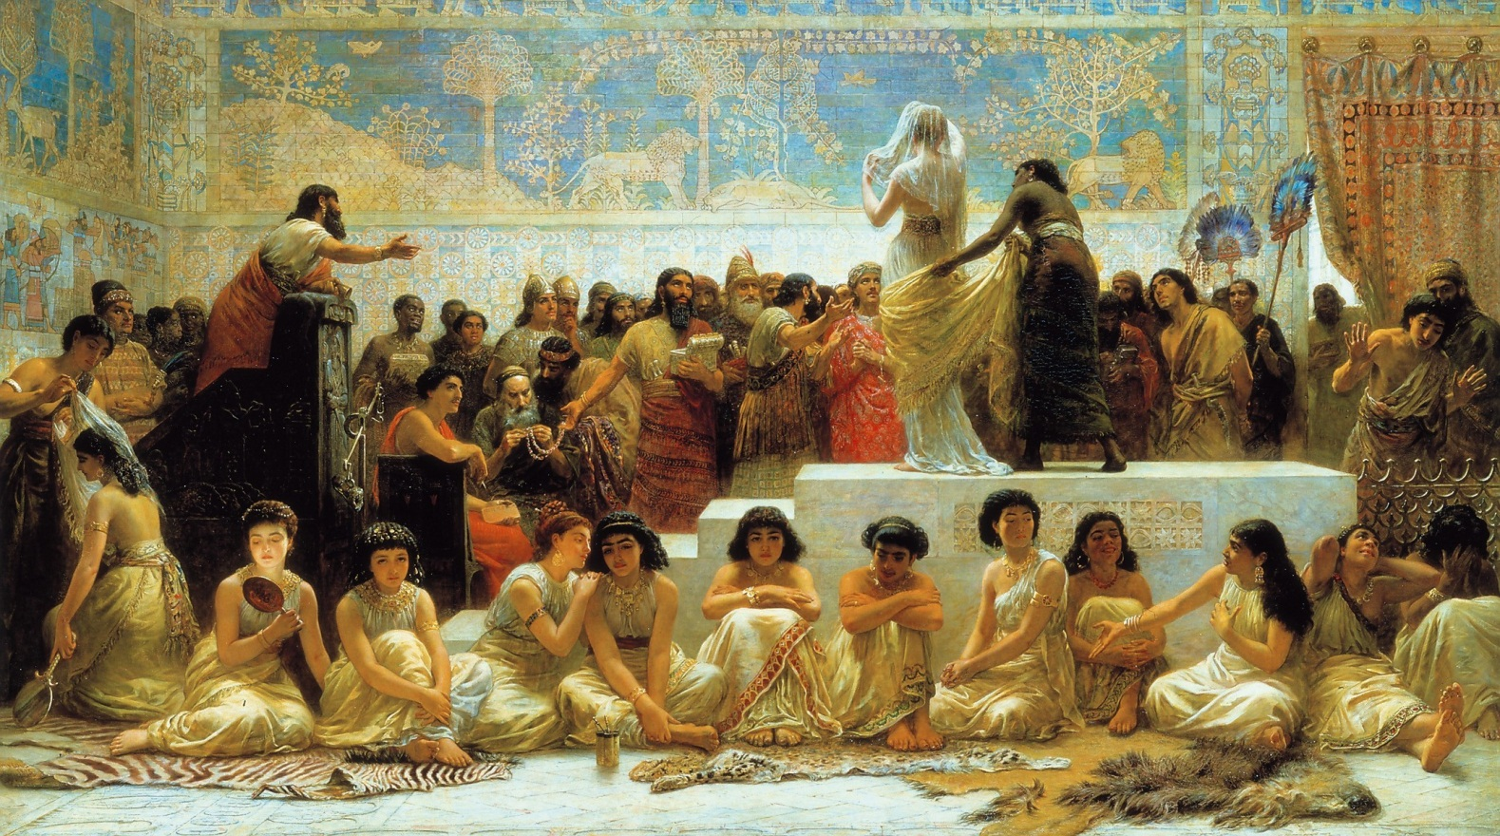
Conceptualizing Capitalism
Lecture 2: Property, exchange and markets
Babylonian auction market for marriage rights in the sixth century BC.
/ 27

Slide 22
Conceptualizing Capitalism
Lecture 2: Property, exchange and markets
Markets
There has been debate on whether ancient civilizations were mainly market economies (Finley 1962, Polanyi at al. 1957).
Peter Temin (2002) examined recorded price data of goods from Babylon from 464 to 72 BC and concluded that the longer time-series of apparently responsive and readily adjustable prices was evidence of market forces in operation.
Temin (2001, 2006) and others have argued that the Roman Empire contained developed and interlocking markets with variable prices.
/ 27

Slide 23
Conceptualizing Capitalism
Lecture 2: Property, exchange and markets
Financial Markets
Bond markets began in Venice in 1171.
In 1309 a “Beurse” was organized in Bruges in Flanders, apparently named after the Van der Beurse family, who had previously hosted regular exchanges of material goods.
In 1602 the Dutch East India Company issued the first shares on the Amsterdam Bourse.
The London Stock Exchange, founded in 1801, but in 1697 goods and stock prices began to be published in a coffee house.
The New York Stock Exchange – in 1792 some stockbrokers organized a market for stocks in Wall Street.
/ 27

Slide 24
Conceptualizing Capitalism
Lecture 2: Property, exchange and markets
Markets
Ludwig von Mises (1949) saw the market economy as “the social system of the division of labour under private ownership of the means of production.”
For von Mises, all feasible economies are market economies.
An alternative notion: A market is an institution through which multiple buyers and multiple sellers exchange rights to a substantial number of commodities of a particular type.
Involves institutional mechanisms to set prices etc..
/ 27

Slide 25
Conceptualizing Capitalism
Lecture 2: Property, exchange and markets
Markets
The institutional character of markets was emphasised by the German historical school, and by ‘old’ institutional economists such as John Commons, John Hobson and John Maurice Clark.
Hobson (1902): “A market, however crudely formed, is a social institution.”
J. M. Clark (1957): “the mechanism of the market, which dominates the values that purport to be economic, is not a mere mechanism for neutral recording of people’s preferences, but a social institution with biases of its own”.
/ 27

Slide 26
Conceptualizing Capitalism
Lecture 2: Property, exchange and markets
Relational exchange
George B. Richardson (1972), Victor P. Goldberg (1980) and Ronald Dore (1983) established that many real-world commercial transactions do not take place in competitive market arenas.
= “relational exchange” or “relational contracting.”
/ 27

Slide 27
Conceptualizing Capitalism
Lecture 2: Property, exchange and markets
Key points on markets:
Markets are institutions – organised exchange
Markets emerged up to 5000 years ago
Different types of market institutions exist
Not all trade takes place in markets
/ 27

