Slide 1
Conceptualizing Capitalism Institutions, Evolution, Future
Geoffrey M Hodgson
Introduction
DISCOVERING CAPITALISM
1. Distilling the essence
2. Social structure and individual motivation
3. Law and the state
4. Property, possession and contract
5. Commodity exchange and markets
6. Money and finance
7. Meanings of capital
8. Firms and corporations
9. Labor and employment
10. The essence of capitalism
/ 26

Slide 2
Conceptualizing Capitalism Institutions, Evolution, Future
Geoffrey M Hodgson
ASSESSING CAPITALISM
Conceptualizing production
Socialism, capitalism, and the state
How does capitalism evolve?
The future of global capitalism
Addressing inequality
Capitalism and beyond
Coda on legal institutionalism
Today’s Lecture
/ 26

Slide 3
Conceptualizing Capitalism
Lecture 9: Capitalism, inequality and beyond
Capitalism embodies and sustains an Enlightenment agenda of freedom and equality …
but somehow generates great inequalities of income and wealth.
/ 26

Slide 4
Conceptualizing Capitalism
Lecture 9: Capitalism, inequality and beyond
Themes of this lecture:
Factor asymmetry and exploitation
Sources of inequality within capitalism
Alleviating inequality
Abolition of the employment relationship?
Knowledge intensification and employment
Cooperatives and corporate reform
Conclusion – beyond left and right
/ 26

Slide 5
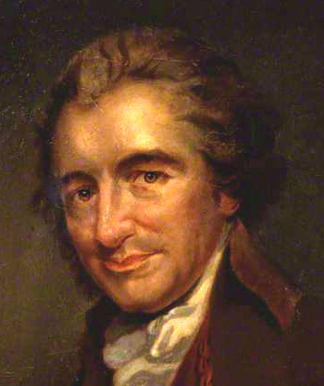
Conceptualizing Capitalism
Lecture 9: Capitalism, inequality and beyond
“The contrast of affluence and wretchedness continually meeting and offending the eye, is like dead and living bodies chained together.”
Thomas Paine (1797)
/ 26

Slide 6
Conceptualizing Capitalism
Lecture 9: Capitalism, inequality and beyond
Exploitation:
Circularity of labour theory of value.
A asymmetric authority in the employment contract – authority exploitation (Hodgson 1982).
Unlike other factors, the worker and her labour-power are inseparable – corporeal exploitation (Green 1888, Marshall 1890, Hobson 1929, Hodgson 1982).
Deal with corporeal exploitation by abolishing incomes from ownership of other factors of production?
/ 26

Slide 7
Conceptualizing Capitalism
Lecture 9: Capitalism, inequality and beyond
Exploitation:
Freedom from enslavement denies the employee opportunities for obtaining loans using labour assets as collateral. – uncollateralizability exploitation.
Unequal access to collateral is a major source of further inequality.
Book of Matthew: “for whosoever hath, to him shall be given, and he shall have more abundance: but whosoever hath not, from him shall be taken away even that he hath.”
/ 26

Slide 8
Conceptualizing Capitalism
Lecture 9: Capitalism, inequality and beyond
Further sources of inequality in capitalism:
Much of the inequality of wealth found within capitalism results from inequalities of inheritance.
To what extent does this inheritance derive from before capitalism?
Need to focus on generators of wealth within capitalism.
/ 26

Slide 9
Conceptualizing Capitalism
Lecture 9: Capitalism, inequality and beyond
Do markets generate inequality?
Oligopoly and inequality.
Joseph Stiglitz (2012): “Markets … often lead to high levels of inequality.”
But in chapter on “markets and inequality”, Stiglitz blamed not markets, but how they are “shaped”.
/ 26

Slide 10
Conceptualizing Capitalism
Lecture 9: Capitalism, inequality and beyond
Does globalisation generate inequality?
Branko Milanovic (2011) – global income inequality has increased slightly since 1950.
Most global income inequality due to differences between countries, rather than within countries.
It is possible for inequality to increase within every country while global inequality decreases (Milanovic 2005).
/ 26

Slide 11
Conceptualizing Capitalism
Lecture 9: Capitalism, inequality and beyond
The foremost generator of inequality under capitalism is not markets …
… but capital.
Capital is money, or the realizable money-value of owned and collateralizable property.
/ 26

Slide 12
Conceptualizing Capitalism
Lecture 9: Capitalism, inequality and beyond
Alleviating inequality
Thomas Paine (1797) – old-age pension, plus a state-funded, distribution “to every person, when arrived at the age of twenty-one years, the sum of fifteen pounds sterling, as a compensation in part, for the loss of his or her natural inheritance, by the introduction of the system of landed property.”
£15 converts to about £79,000 or $120,000 as an equivalent share of 2011 UK GDP.
/ 26

Slide 13
Conceptualizing Capitalism
Lecture 9: Capitalism, inequality and beyond
Alleviating inequality
Bruce Ackerman and Anne Alstott (1999) – “stakeholder society”
Stress on progressive taxes on wealth, not income.
Proposed a large cash grant to all citizens when they reach the age of majority.
Gradual implementation of an annual wealth tax of two per cent on a person’s net worth above $80,000.
See also Samuel Bowles and Herbert Gintis (1999)
/ 26

Slide 14
Conceptualizing Capitalism
Lecture 9: Capitalism, inequality and beyond
Alleviating inequality
As economies become more knowledge-intensive, access to education to develop skills becomes all the more important.
Need for skill-development policies alongside integrated measures to deal with job displacement and unemployment (Ashton and Green 1996, Crouch, Finegold, and Sako 1999, Acemoglu and Autor 2011, 2012).
/ 26

Slide 15
Conceptualizing Capitalism
Lecture 9: Capitalism, inequality and beyond
Alleviating inequality
Proposal for basic income guarantee:
Supported by: Milton Friedman, John Kenneth Galbraith, Friedrich Hayek, James Meade, Herbert Simon, Paul Samuelson, Robert Solow, James Tobin
/ 26

Slide 16
Conceptualizing Capitalism
Lecture 9: Capitalism, inequality and beyond
Alleviating inequality
Thomas Paine (1797) – “All accumulation, therefore, of personal property, beyond what a man’s own hands produce, is derived to him by living in society; and he owes on every principle of justice, of gratitude, and of civilization, a part of that accumulation from whence the whole came.”
/ 26

Slide 17
Conceptualizing Capitalism
Lecture 9: Capitalism, inequality and beyond
Beyond capitalism? Capitalism defined:
A legal system supporting widespread individual rights and liberties to own, buy and sell private property.
Widespread commodity exchange, markets, money.
Widespread private ownership of the means of production, by firms producing goods or services in the pursuit of profit.
Much of production organized separately and apart from the home and family.
Widespread wage labor and employment contracts.
A developed financial system with banking institutions, the widespread use of property as collateral, and selling of debt.
/ 26

Slide 18
Conceptualizing Capitalism
Lecture 9: Capitalism, inequality and beyond
Abolition of the employment relationship?
David Ellerman: asymmetric authority – hiring people
Is the abolition of authority at work feasible?
Problem in worker cooperatives - difficulty of shareholder exit
/ 26

Slide 19
Conceptualizing Capitalism
Lecture 9: Capitalism, inequality and beyond
Knowledge intensification and employment
Peter Drucker (1993) the knowledge-intensive organization “is increasingly composed of specialists, each of whom knows more about his or her own specialty than anybody else in the organization.”
Shoshana Zuboff (1988) dematerialization of much production, and the shift from physical to intellective skills.
/ 26

Slide 20
Conceptualizing Capitalism
Lecture 9: Capitalism, inequality and beyond
Knowledge intensification and employment
As the complexity and knowledge-intensity of production processes increase, the key characteristic in the employment contract of detailed managerial control is bounded and impaired.
But developments in information technology increase possibilities for workforce surveillance (Head 2005).
/ 26

Slide 21
Conceptualizing Capitalism
Lecture 9: Capitalism, inequality and beyond
Cooperatives and corporate reform
Experimentation with an enlarged sector with worker-owned enterprises.
Extension of worker shareholding in ordinary corporations.
The US-based National Center for Employee Ownership (2012): in about 2010 about 10,900 enterprises, involving 10.3 million workers, were part of employee-ownership, stock bonus, or profit-sharing schemes, with assets estimated at about $869 billion.
/ 26

Slide 22
Conceptualizing Capitalism
Lecture 9: Capitalism, inequality and beyond
Conclusion – beyond left and right
Originally “left” meant – liberté, égalité, fraternité – opposition to monarchy, aristocracy, church institutions and privilege.
/ 26

Slide 23
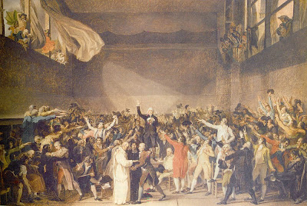
Conceptualizing Capitalism
Lecture 9: Capitalism, inequality and beyond
Conclusion – beyond left and right
Origins of “left” and “right” in French National Convention.
/ 26

Slide 24
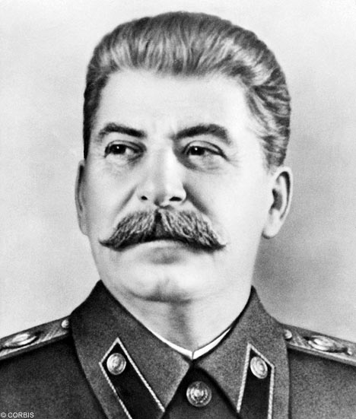
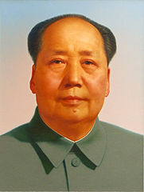
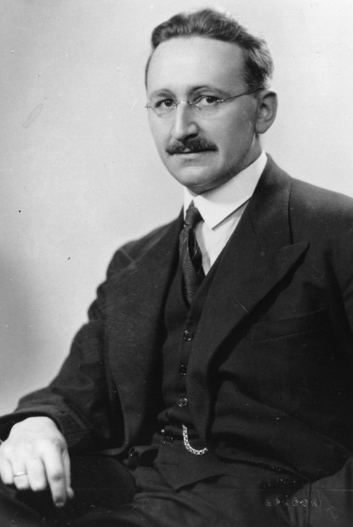
Conceptualizing Capitalism
Lecture 9: Capitalism, inequality and beyond
By 1900 “left” meant common ownership of the means of production – then Stalin & Mao
The term “right” also shifted, to defence of free markets and private ownership – not conservative
The “right” occupied the former territory of the “left”
/ 26

Slide 25
Conceptualizing Capitalism
Lecture 9: Capitalism, inequality and beyond
Conclusion – beyond left and right
The socialist movement got it wrong, by prioritizing the abolition of private property and markets.
Markets and private ownership existed for thousands of years before capitalism.
People cannot function effectively in a system of contracts and markets if they are deprived of food, shelter, basic education or fruitful social interaction.
⇒ Free-market principles imply a welfare state.
/ 26

Slide 26
Conceptualizing Capitalism
Lecture 9: Capitalism, inequality and beyond
Conclusion – beyond left and right
Limits to markets – externalities etc.
By pushing back slavery and establishing a system of wage-labor, capitalism limited the market at its core: it disallowed complete futures markets for labor power.
Because of ban on slavery, workers cannot be used as collateral for obtaining loans. Workers cannot be separated from labour in production.
The central problem in capitalism is inequality.
/ 26

