Slide 1
What is Capital?
Geoffrey M. Hodgson
g.m.hodgson@herts.ac.uk
www.geoffrey-hodgson.info
1. Introduction
2. A brief history of the c-word
3. Can humans be capital?
4. Further accumulations of “capital”
5. Social capital
6. Conclusion: capital as money
/ 29

Slide 2
What is Capital?
1. Introduction
Based on a chapter from:
Conceptualizing Capitalism:
Institutions, Evolution, Future
University of Chicago Press, late 2014
/ 29

Slide 3
What is Capital?
1. Introduction
Understanding capital-ism ⇒ Understanding capital
Much of economics makes capital an ahistorical concept.
The Crisis of 2007 and after – the need to review fundamental concepts.
/ 29

Slide 4
What is Capital?
2. A brief history of the c-word
“Capital” originally referred to head counts of cattle: a measure of wealth.
Fernand Braudel, Civilization and Capitalism (1982): the word capitale was in use in Italy in 1211 and is found from 1283 “in the sense of the capital assets of a trading firm”
The word gradually came to mean the “money capital of a firm or of a merchant” and spread through Western Europe.
/ 29

Slide 5
What is Capital?
2. A brief history of the c-word
In Britain, from the sixteenth to eighteenth centuries, “capital” meant money:
Postlethwayt’s Universal Dictionary of Trade and Commerce (1751):
“CAPITAL, amongst merchants, bankers, and traders, signifies the sum of money which individuals bring to make up the common stock of a partnership when it is first formed. It is also said of the stock which a merchant at first puts into trade, for his account. It signifies likewise the fund of a trading company or corporation, in which sense the word stock is generally added to it.”
/ 29

Slide 6
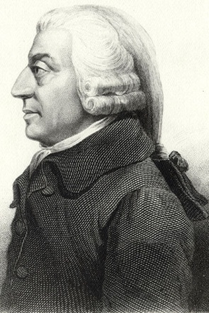
What is Capital?
2. A brief history of the c-word
Enter Adam Smith (1776):
The ‘nature’ of wealth was physical stuff, typically produced by other stuff.
Money too became a thing with intrinsic value, produced by labour.
Capital became produced physical stuff that is useful to purchase or produce other stuff.
/ 29

Slide 7
What is Capital?
2. A brief history of the c-word
Adam Smith (1776)
… wrote of “the acquired and useful abilities of all the inhabitants or members of the society. The acquisition of such talents, by the maintenance of the acquirer during his education, study, or apprenticeship, always costs a real expense, which is a capital fixed and realized, as it were, in his person.”
/ 29

Slide 8
What is Capital?
2. A brief history of the c-word
Edwin Cannan (1921) on Smith’s words:
“This indicates a very serious departure from the conception of capital which had hitherto prevailed. Instead of making the capital a sum of money which is to be invested, or which has been invested in certain things, Smith makes it the things themselves.”
/ 29

Slide 9
What is Capital?
2. A brief history of the c-word
Nassau W. Senior (1836):
“Economists are agreed that whatever gives a profit is properly termed capital.”
John Stuart Mill (1871)
defined capital as the “accumulated stock of the produce of labour.”
Karl Marx, in Capital, vol 1 (1867):
“capital is not a thing, but a social relation between persons, established by the instrumentality of things.”
/ 29

Slide 10
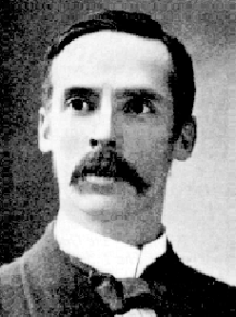
What is Capital?
2. A brief history of the c-word
John A. Hobson (1894):
Economists dispute the meaning of capital, while “ignoring the clear and fairly constant meaning the term actually possesses in the business world around them.”
Hobson pointed out that in the “business world” capital meant “money or the control of money, sometimes called credit”
/ 29

Slide 11
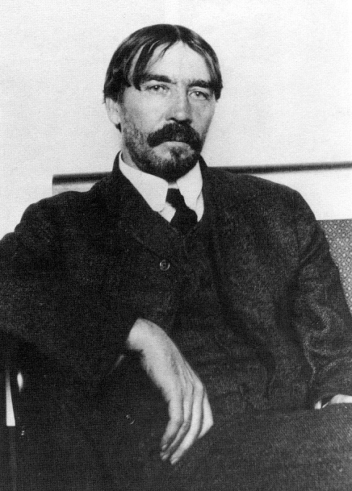
What is Capital?
2. A brief history of the c-word
Thorstein Veblen (1908):
“In current usage, in the business community, ‘capital’ is a pecuniary concept … and is not definable in mechanical terms; but Mr. Clark … sticks by the test of mechanical demarcation and draws the lines of his category on physical grounds; whereby it happens that any pecuniary conception of capital is out of the question. Intangible assets, or immaterial wealth, have no place in the theory … [Instead there is a] conception of capital, as a physically ‘abiding entity’ constituted by the succession of productive goods that make up the industrial equipment …”
/ 29

Slide 12
What is Capital?
2. A brief history of the c-word
Alfred Mitchell Innes (1914):
“How complete the divorce is between the experience of daily life and the teaching of the economists can best be seen by reading, for example, Marshall's chapter on capital, with its complicated divisions into national capital, social capital, personal capital, etc.. Every banker and every commercial man knows that there is only one kind of capital, and that is money. …
… Every commercial and financial transaction is based on the truth of this proposition, every balance sheet is made out in this well-established fact. And yet every economist bases his teaching on the hypothesis that capital is not money.”
/ 29

Slide 13
What is Capital?
2. A brief history of the c-word
Frank Fetter:
(1927) “Capital is essentially an individual acquisitive, financial, investment ownership concept. It is not coextensive with wealth as physical objects, but rather with legal rights as claims to uses and incomes. It is or should be a concept relating unequivocally to private property and to the existing price system.”
(1930) “Capital is defined as a conception of individual riches having real meaning only within the price system and the market where it originated, and developing with the spread of the financial calculus in business practice.”
/ 29

Slide 14
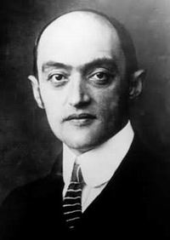
What is Capital?
2. A brief history of the c-word
Joseph A. Schumpeter (1954):
“The word Capital had been part of legal and business terminology long before economists found employment for it. With the Roman jurists and their successors, it denoted the ‘principal’ of a loan as distinguished from interest and other accessory claims of the lender. In obvious relation with this, it later came to denote the sums of money or their equivalents brought by partners into a partnership or company, the sum total of a firm’s assets, and the like. …”
/ 29

Slide 15
What is Capital?
2. A brief history of the c-word
Joseph A. Schumpeter (1954):
“… Thus the concept was essentially monetary, meaning either actual money, or claims to money, or some goods evaluated in money. ... What a mass of confused, futile, and downright silly controversies it would have saved us, if economists had had the sense to stick to those monetary and accounting meanings of the term instead of trying to ‘deepen’ them!”
/ 29

Slide 16
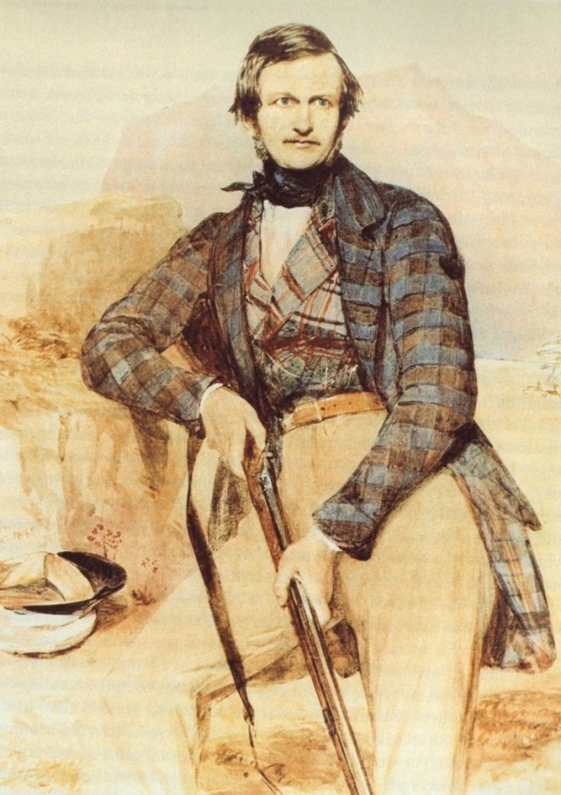
What is Capital?
3. Can humans be capital?
First known appearance of the term “human capital”:
Sir William Cornwallis Harris (1807-1848) – an officer in the army of the East India Company. From his 1842 Report to the Secretary of the Bombay Government (on the African slave-trade):
“Few, if any, of the commodities which [Africa] barters with other countries for the rude and limited supplies that she seeks are the production of human capital, labour, or industry.”
/ 29

Slide 17
What is Capital?
3. Can humans be capital?
Scottish-born merchant, historian, statistician and Australian politician William Westgarth (1875):
“labour can be wealth or capital … only when it is bonded, and thus rendered a definite subject of exchangeable value. It is in this sense that a slave is true capital, but not a free man. Labour brings wealth into being, but … it is not itself wealth. … A slave is a definite marketable subject, and is capital, but a free agent is not.”
/ 29

Slide 18
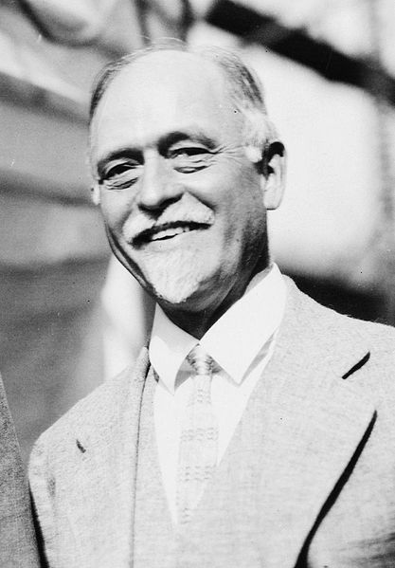
What is Capital?
3. Can humans be capital?
First appearance of the term “human capital” in a prominent journal of economics:
Irving Fisher (1897), proposed that all factors of production, including machines, land and labour, should be described as “capital”.
/ 29

Slide 19
What is Capital?
3. Can humans be capital?
The term “human capital” became commonplace with Theodore W. Schultz (1960, 1971) and Gary Becker (1964):
But note Schultz (1972): “human capital … cannot be bought and sold except where men are slaves. Whereas material capital has the legal status of property, human capital is not ‘protected’ by this legal mantle, slavery aside. ... Since a person cannot indenture himself or enter into a contract that would encumber his human rights, it follows that in the case of a loan to a student for his education, the lender’s property right in the capital funds that he transfers to the student cannot be covered by a mortgage on the student.”
/ 29

Slide 20
What is Capital?
4. Further accumulations of “capital”
In economics, sociology and related disciplines:
“natural capital” (Johnson 1909),
"health capital" (Grossman 1972),
"religious capital" (Azzi and Ehrenberg 1975),
"linguistic and cultural capital" and "symbolic capital" (Bourdieu 1977),
"reputational capital" (Veljanovski and Whelan 1983),
"social capital" (Bourdieu 1986, Coleman 1988, Putnam 1995),
"organizational capital" (Tomer 1987, Klein 1988),
/ 29

Slide 21
What is Capital?
4. Further accumulations of “capital”
In economics, sociology and related disciplines:
"academic capital" (Bourdieu 1988),
"cultural or consumption capital" (Becker and Murphy 1988),
"cognitive capital" (Rescher 1989),
"symbolic capital" (Bourdieu 1990),
"environmental capital" (Hartwick 1991),
"self-command capital" (Lindenberg 1993),
"network capital" (Sik 1994),
"personal capital" (Dei Ottati 1994, Becker 1996),
/ 29

Slide 22
What is Capital?
4. Further accumulations of “capital”
In economics, sociology and related disciplines:
"political, social and cultural capital" (Mouzelis 1995),
"intellectual capital" (Edvinsson and Malone 1997),
"resource capital and institutional capital" (Oliver 1997),
"spiritual capital" (Verter 2003),
"individual trust capital (relational capital)" (Castelfranchi et al. 2006),
"collective trust capital" (Castelfranchi et al. 2006), and
"street capital" (Sandberg and Pedersen 2009).
“erotic capital” (Hakim 2011)
/ 29

Slide 23
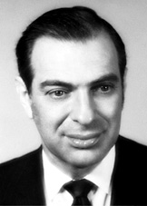
What is Capital?
5. Social capital
Prominent criticisms:
Kenneth Arrow (1999):
“The term ‘capital’ implies three aspects: (a) extension in time; (b) deliberate sacrifice in the present for future benefit; and (c) alienability. The last is not true for human capital and not even entirely true for [irreversible] physical investment … But it is especially (b) that fails. The essence of social networks is that they are built up for reasons other than their economic value to the participants.”
But (b) is not the central point.
/ 29

Slide 24
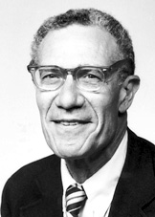
What is Capital?
5. Social capital
Prominent criticisms:
Robert Solow(1999):
“Generically ‘capital’ stands for a stock of produced or natural factors of production that can be expected to yield productive services for some time. Originally anyone who talked about capital had in mind a stock of tangible, solid, often durable things such as buildings, machinery and inventories.”
Again this is not the central point.
/ 29

Slide 25
What is Capital?
5. Social capital
Prominent criticisms:
Samuel Bowles (1999):
“‘Capital’ refers to a thing possessed by individuals; even a social isolate like Robinson Crusoe had an axe and a fishing net. By contrast, the attributes said to make up social capital – such as trust, commitment to others, adhering to social norms and punishing those who violate them – describe relationships among people.”
This confuses property with possession.
/ 29

Slide 26
What is Capital?
5. Social capital
Both advocates and critics of “social capital” miss the most important points:
Not only is “social capital” inalienable …
hence it has no market-determined monetary value …
But also it cannot be used as collateral.
/ 29

Slide 27
What is Capital?
6. Conclusion: capital as money
Consider forms of “capital”:
Can its use-rights (i.e. usus or usus fructus rights) be owned or hired?
Has this form of capital a price formed in the market for capital of this type?
Can this kind of capital be used as collateral to borrow money?
Can this kind of capital be sold with all rights of ownership transferred to the purchaser?
Is the value of this kind of capital measurable?
/ 29

Slide 28
What is Capital?
6. Conclusion: capital as money
 | Types of ‘Capital’
 | Capital (as finance or collateral) | ‘Capital Goods’ | ‘Human Capital’ | ‘Social Capital’
Can the use-rights be owned or hired? | Yes | Yes | Yes | No
Has it a market price? | Yes | Yes – in many cases | Wage-labour allows a price for use-rights only | No
Can it be used as collateral? | Yes | Yes | No – except in the case of slaves | No
Can it be bought or sold (alienated)? | Yes | Yes | No – except in the case of slaves | No
Is it readily measurable in the aggregate? | Yes | No – except by assuming a list of relevant prices | No – except by assuming a list of relevant wages | No
/ 29

Slide 29
What is Capital?
6. Conclusion: capital as money
Arguments for returning to “capital” as money, or collateralizable wealth:
Historical specificity – “capitalism”.
Otherwise we need a different word or phrase to describe monetary or collateralizable assets.
The over-extension of the word degrades meaning.
The over-extension of the word brings ideological connotations of saleability.
The primary source of inequality is differential collateralizability.
/ 29

